Slide 1

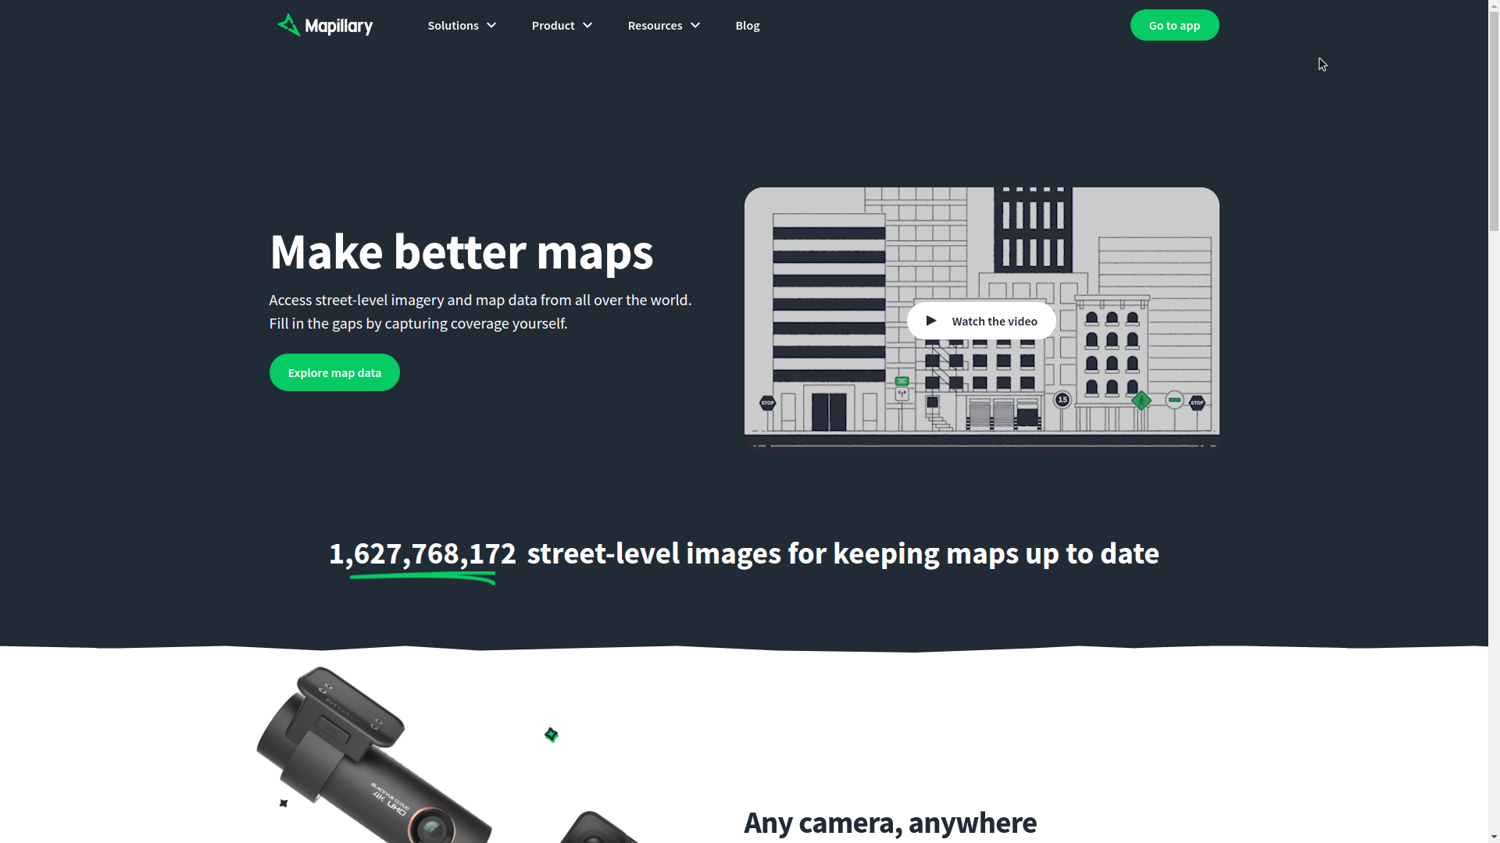
Mapillary
Keep maps detailed and up to date
See what places look like through street-level imagery and add more details to maps.

Slide 2
Mapillary
The Problem
GeoSpatial & GeoInformatics
Solution Proposal
Next Steps

Slide 3
Problem statement
Keeping maps easy to update and fresh for use

Slide 4
GeoSpatial & GeoInformatics
MapBox
Esri
ArcGis

Slide 5
Solution Proposal
Mapillary provides,
Map updation via uploading images from Desktops/Mobile/GoPro
Tools for helping upload material
More than 75%+ of data on Mapillary is contributed by users!
Structure From Motion (SFM) - 2D to 3D pixel forecasting for building 3D structures
Pipeline for Computer Vision
MapillaryJS - Interactive, extendable street imagery visualization platform
ArcGIS support
OpenSFM library for Structure From Motion
Open Source technologies

Slide 6
So why use Mapillary?
Why not stick to Google maps?
Pros: It’s Google
Cons: It’s only Google

Slide 7
Mapillary’s Python SDK
An SDK for interacting with the most recent Mapillary API v4 release, which introduced a lot of changes. While also catering to future possible API release 1-2 years down the road,
From scratch implementation, we only had a Product Requirement Document (PRD) to start with
Forward Compatibility, implementing DRY. Focusing on maintainability, readability, modularity, structure, and best practices
So far, 65 issues (44 closed), 43 PRs (39 merged), 7.9K+ LoCs, 305 commits
Preparing for a release, documentation, and writing unit tests
Already incoming traffic with 1,600+ views, and 150+ unique visitors
Thinking about being Open Source friendly as possible. Facebook guidelines follow up
Currently under facebookincubator

Slide 8
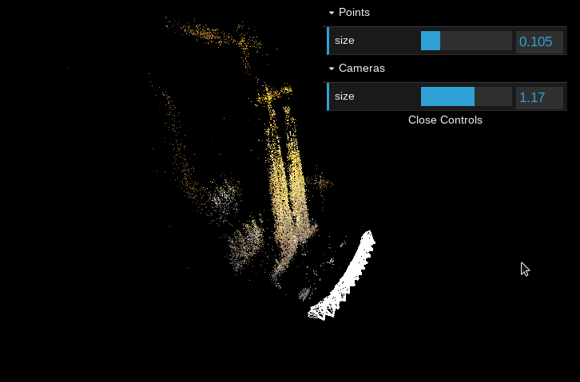
Open Sourcing 3D City Reconstruction
01
1
One of the downsides of using simple devices for mapping the world is that the GPS accuracy is not always great, especially in cities with tall buildings. Since the start we have always wanted to correct this using image matching and we are now making progress in that area.

Slide 9
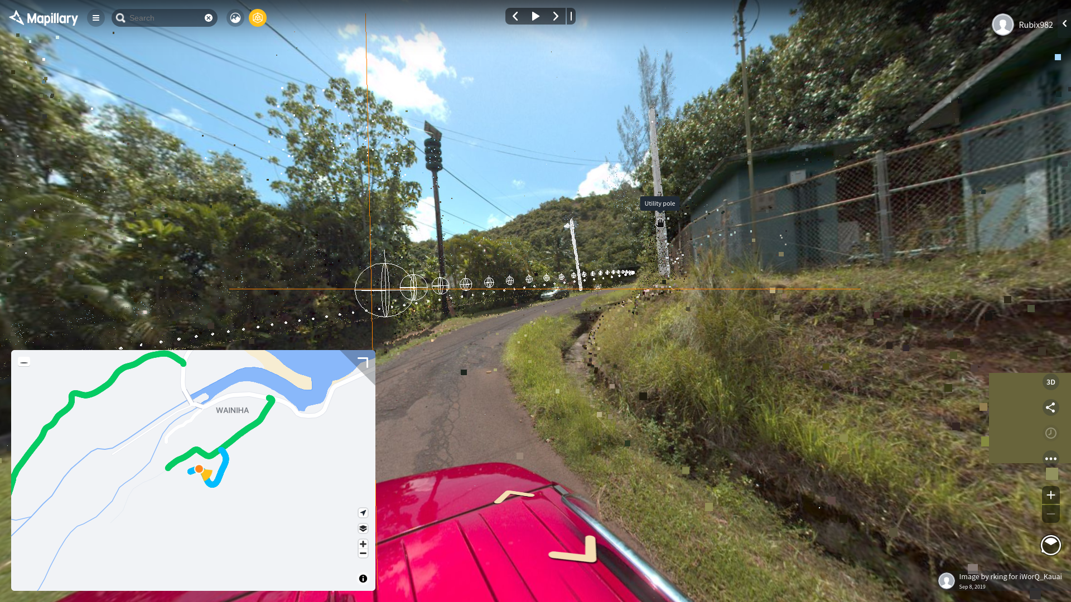
Getting Environment Information
02
Develop your algorithms with diverse data from all over the world, including different weather, season, time of day, camera, and viewpoint conditions.

Slide 10
API Documentation “At A Glance”
03
Root endpoint for metadata - https://graph.mapillary.com
Root endpoint for vector tiles - https://tiles.mapillary.com
Coverage tiles - https://tiles.mapillary.com/maps/vtp/mly1_public/2/{z}/{x}/{y}
Computed coverage tiles - https://tiles.mapillary.com/maps/vtp/mly1_computed_public/2/{z}/{x}/{y}
Map features (points) tiles - https://tiles.mapillary.com/maps/vtp/mly_map_feature_point/2/{z}/{x}/{y}
Map features (traffic signs) tiles - https://tiles.mapillary.com/maps/vtp/mly_map_feature_traffic_sign/2/{z}/{x}/{y}
All of the API Documentation for APIv4 is available here

Slide 11

Team Lead
04
Christopher Beddow
Team Lead // Map Building At Facebook Reality Labs
In the team
Helping and guiding the direction of the project, prioritizing, answering every single question we have & introducing us to many on Mapillary’s team!

Slide 12
Why it’s better than existing solutions
Open Source!

Slide 13
What next?
After the documentation and PyPI release? We’re not sure
Finishing a few left over issues on GitHub

Slide 14
Timeline
JUN
JULY
AUG
SEPT
SEPT
Design Thinking & Requirement Analysis
Coding, coding, coding!
Wrapping up + release + future planning
?????
???

Slide 15
What we need help with
A few good issues, more about project maintenance
More coming in the future (to infinity and beyond)

Slide 16
Questions?

Slide 17
References
Mapillary Python SDK
API Documentation
GitHub - Mapillary

